Slide 1

SCHOOL OF COMPUTER SCIENCE AND ENGINEERING • IILM UNIVERSITY, GREATER NOIDA
Machine Learning Internship at CodeAlpha
Handwritten Character Recognition using CNN & Speech Emotion Recognition using Deep Learning
ADARSH KUMAR THAKUR
Roll No.: CS-2341736 | Batch: 2026–2027 | B.Tech CSE
Internship Duration: 20th July 2026 – 20th August 2026
Click through the sections below to explore — an interactive project report

Slide 2






Agenda
Click any section to jump straight to it
01
About CodeAlpha
02
Internship Overview
Organization profile & internship track
Duration, role & objectives
03
Project 1 – Digit Recognition
04
Project 2 – Speech Emotion
CNN on MNIST | 99.11% accuracy
Deep Learning on speech audio
05
Comparison & Key Learnings
06
Certification & Closing
Skills gained across both projects
Proof of completion & acknowledgements
IILM University, Greater Noida | School of Computer Science and Engineering
2

Slide 3


← Agenda
ABOUT THE ORGANIZATION
CodeAlpha — Organization Profile
A technology-focused organization offering virtual internship programs in Machine Learning, Web Development, Android Development, Data Science, Python, and Cyber Security.
Mission: bridge the gap between academic learning and industry requirements through practical, project-based internship experiences.
Interns select and independently implement projects from a defined task list within a fixed duration.
On successful completion, CodeAlpha issues an official Certificate of Completion and a Letter of Recommendation.
TRACK
Machine Learning
RECOGNITION
MCA, Govt. of India ref.
FORMAT
Virtual / Remote
IILM University, Greater Noida | School of Computer Science and Engineering
3

Slide 4
← Agenda
INTERNSHIP OVERVIEW
Duration, Role & Objectives
DURATION
ROLE
20th July 2026 – 20th August 2026 (1 Month)
Machine Learning Intern
MODE
PROJECTS COMPLETED
Virtual Internship Program
2 independent end-to-end ML/DL projects
Key Objectives
Apply core Machine Learning and Deep Learning concepts to real, practical problem statements.
Build the complete ML pipeline: data preprocessing → model design → training → evaluation → deployment.
Deploy trained models as interactive, usable web applications (Streamlit and Flask).
IILM University, Greater Noida | School of Computer Science and Engineering
4

Slide 5
← Agenda
PROJECT 01
Handwritten Character Recognition
using Convolutional Neural Networks (CNN)
MNIST Dataset • TensorFlow / Keras • OpenCV • Streamlit
IILM University, Greater Noida | School of Computer Science and Engineering
5

Slide 6

← Agenda
PROJECT 1
Problem Statement & Objectives
Objectives
Problem Statement
Design a CNN capable of recognizing handwritten digits from image data.
Preprocess raw digit images using OpenCV for CNN-ready input.
Train & validate on the MNIST dataset for high test accuracy.
Evaluate using precision, recall, F1-score, and confusion matrix.
Deploy as an interactive Streamlit web app with confidence scores.
Handwriting varies widely from person to person in shape, size, slant, and stroke thickness, making rule-based digit recognition unreliable. The goal was to design and train a deep learning model that accurately classifies a handwritten digit image (0–9) into its correct class — with applications in postal sorting, cheque processing, and OCR.
IILM University, Greater Noida | School of Computer Science and Engineering
6

Slide 7




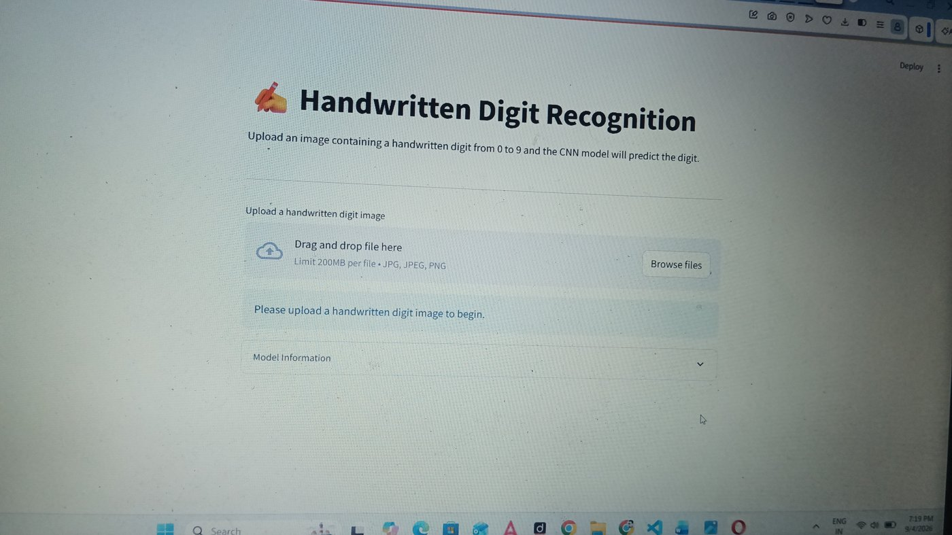
← Agenda
PROJECT 1
System Architecture — Working Pipeline
Image Upload
Preprocessing
CNN Model
Softmax Output
Prediction
User uploads a handwritten digit image via Streamlit
Grayscale, resize to 28×28, normalize (OpenCV)
Conv + Pooling + Dense layers extract & classify features
Probability distribution across 10 digit classes
Predicted digit + confidence score shown to user
The CNN pipeline mirrors a standard image-classification workflow — from raw pixel input to a confident, human-readable prediction on the deployed Streamlit app shown alongside.
IILM University, Greater Noida | School of Computer Science and Engineering
7

Slide 8





← Agenda
PROJECT 1
Technologies & Tools Used
Python
TensorFlow / Keras
CNN Architecture
OpenCV
Core programming language
CNN design & training
Conv, pooling, dense layers
Image preprocessing
NumPy
Scikit-learn
Streamlit
MNIST Dataset
Numerical operations
Precision, recall, F1, confusion matrix
Interactive web deployment
60k train / 10k test digit images
IILM University, Greater Noida | School of Computer Science and Engineering
8

Slide 9
← Agenda
PROJECT 1
Model Performance & Results
99.11%
0.0298
0.9910
TEST ACCURACY
TEST LOSS
MACRO F1-SCORE
Key Observations
Consistently strong performance across all ten digit classes.
Low test loss (0.0298) indicates confident, well-calibrated predictions.
Confusion matrix confirmed minimal misclassification between visually similar digits (e.g., 4 vs 9).
IILM University, Greater Noida | School of Computer Science and Engineering
9

Slide 10
← Agenda
PROJECT 1
Live Application — Streamlit Interface
How it Works
User drags & drops or browses a digit image (JPG/PNG).
The app preprocesses the image and feeds it to the trained CNN.
Predicted digit is displayed instantly with a confidence score.
Model details and performance metrics are viewable in-app.
IILM University, Greater Noida | School of Computer Science and Engineering
10

Slide 11
← Agenda
PROJECT 02
Speech Emotion Recognition
using Deep Learning
Librosa (MFCC) • TensorFlow / Keras • Flask • Matplotlib
IILM University, Greater Noida | School of Computer Science and Engineering
11

Slide 12

← Agenda
PROJECT 2
Problem Statement & Objectives
Objectives
Problem Statement
Develop a DL system to classify emotion from speech audio.
Extract MFCC features that capture emotional characteristics.
Design, train & evaluate a deep learning classification model.
Integrate the model with a Flask web app for live predictions.
Document real-world challenges: noise, voice & recording variance.
Human speech carries emotional information through tone, pitch, and rhythm — valuable for call-center analysis, virtual assistants, and human-computer interaction. The goal was to build a deep-learning system that analyzes raw speech audio and correctly classifies the expressed emotion, despite variation in speakers, recording conditions, and background noise.
IILM University, Greater Noida | School of Computer Science and Engineering
12

Slide 13

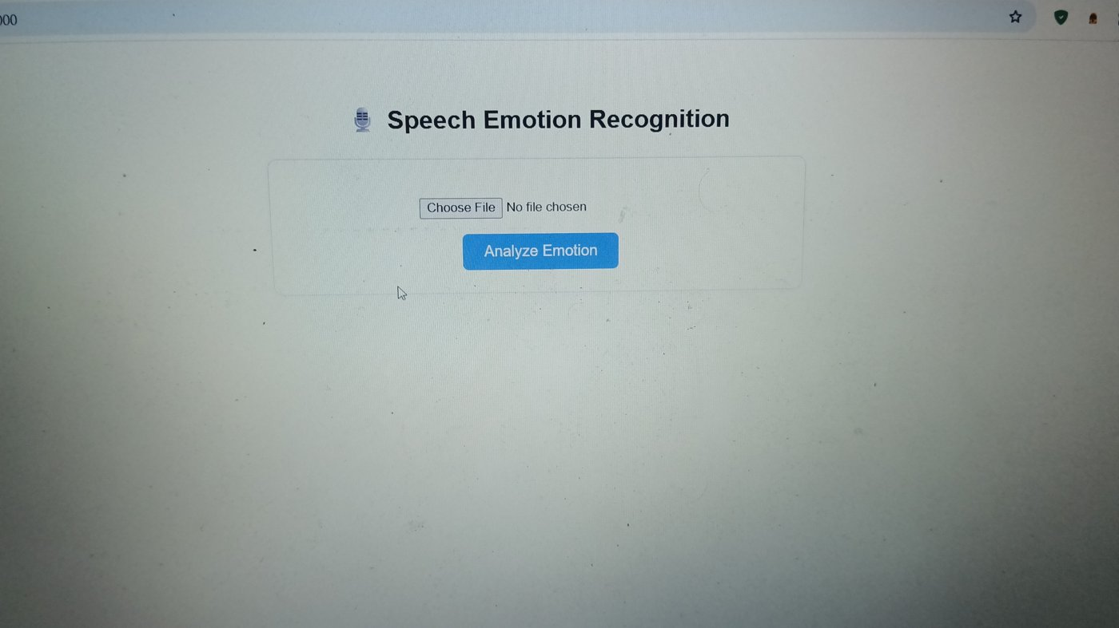
← Agenda
PROJECT 2
System Architecture — Working Pipeline
Audio Upload
Feature Extraction
DL Classifier
Flask Backend
Emotion Output
User uploads a .wav speech file via Flask
MFCC features extracted using Librosa
TensorFlow/Keras model maps features to emotion
app.py + predict.py run inference on upload
Predicted emotion + probability breakdown
The Flask backend loads the trained model via predict.py (load_artifacts, predict_emotion) and renders results to the browser, shown alongside.
IILM University, Greater Noida | School of Computer Science and Engineering
13

Slide 14

← Agenda
PROJECT 2
Technologies & Tools Used
Python
TensorFlow / Keras
Librosa
NumPy / Pandas
Core programming language
Deep learning classification model
Audio loading & MFCC extraction
Numerical & tabular data handling
Scikit-learn
Matplotlib
Flask
app.py / predict.py
Model evaluation metrics
Visualization of results
Web application backend
Model loading & inference logic
IILM University, Greater Noida | School of Computer Science and Engineering
14

Slide 15
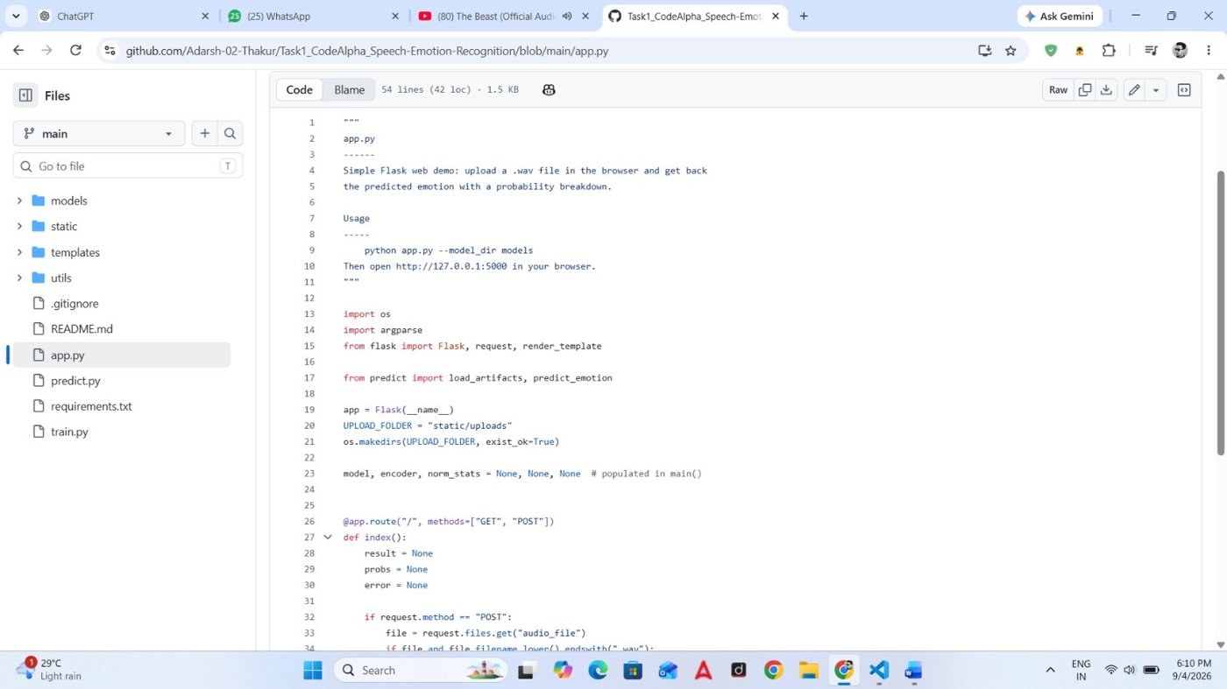
← Agenda
PROJECT 2
Live Application & Source Code
Flask Web Interface
app.py — Flask Backend
IILM University, Greater Noida | School of Computer Science and Engineering
15

Slide 16
← Agenda
COMPARISON
Project 1 vs. Project 2 — At a Glance
Aspect
Digit Recognition
Speech Emotion Recognition
Input Type
Image (handwritten digit)
Audio (speech / .wav file)
Core Model
Convolutional Neural Network
Deep Learning classifier
Feature Extraction
OpenCV image preprocessing
MFCC extraction (Librosa)
Web Framework
Streamlit
Flask
Key Result
99.11% test accuracy
Emotion + probability breakdown
IILM University, Greater Noida | School of Computer Science and Engineering
16

Slide 17

← Agenda
REFLECTIONS
Key Learnings & Skills Gained
Deep Learning Foundations
Image Processing
Audio Signal Processing
Hands-on CNN and DL model design, training, and evaluation.
Preprocessing pipelines using OpenCV for CNN-ready inputs.
Extracting MFCC features from raw speech using Librosa.
Model Evaluation
Web Deployment
Real-World Challenges
Precision, recall, F1-score, and confusion matrix analysis.
Shipping trained models as Streamlit and Flask applications.
Handling handwriting variance, background noise & recording variance.
IILM University, Greater Noida | School of Computer Science and Engineering
17

Slide 18
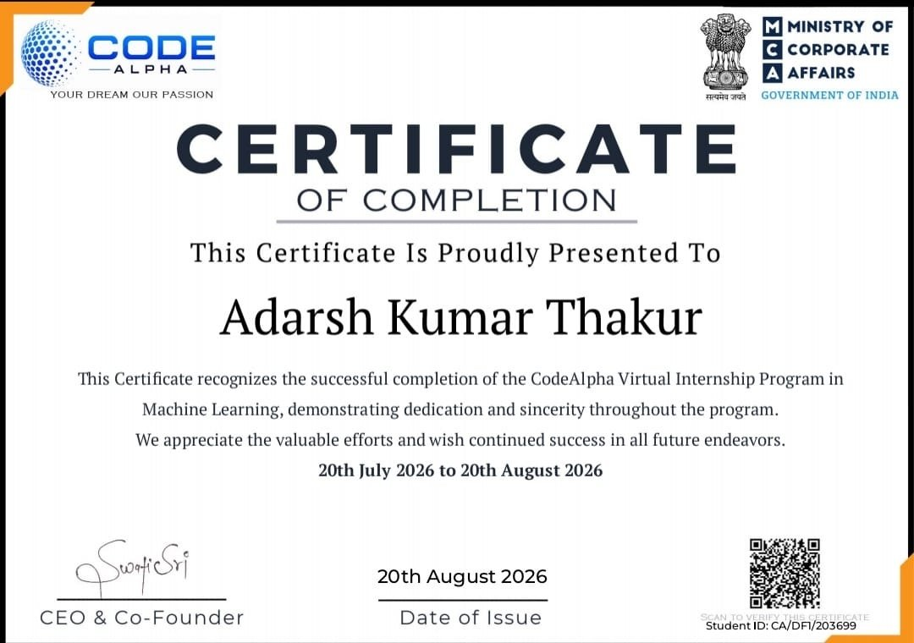

← Agenda
CERTIFICATION
Certificate of Completion & Proof
Verified Details
CodeAlpha Internship Completion Certificate
Recipient: Adarsh Kumar Thakur
Program: CodeAlpha Virtual Internship – Machine Learning
Duration: 20th July 2026 – 20th August 2026
Student ID: CA/DF1/203699
Issued: 20th August 2026, signed by CEO & Co-Founder
Letter of Recommendation also issued alongside the certificate
Certificate & LOR confirmed via official email
from the CodeAlpha Internship team.
IILM University, Greater Noida | School of Computer Science and Engineering
18

Slide 19
Thank You
Grateful to CodeAlpha for the opportunity, and to the School of Computer Science and Engineering,
IILM University, Greater Noida, for their continuous guidance and support.
Adarsh Kumar Thakur
Roll No.: CS-2341736 | B.Tech CSE | Batch 2026–2027
← Back to Agenda

